Slide 1
What are the
Important Aspects of Research?
A grad student’s perspective
PreMAP 2026

Slide 2
Key Aspects of Research
Understanding: You want to understand what other people are doing and most importantly, understand what you are doing.
Doing: In this class, you’ll learn important skills and techniques that are used in astronomical research.
Presenting: When you’ve done science, how do you share what you’ve done? What are good ways and venues to share/present your work?

Slide 3
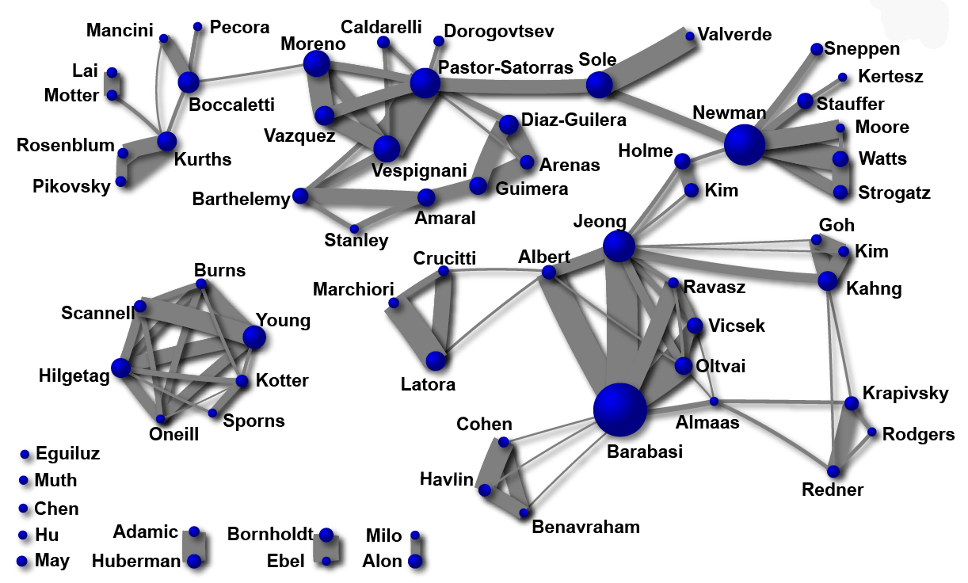
Understanding Science: The Scientific Community
Science is not done in a vacuum, and science is not done alone
Working together means we can bounce ideas off each other, we can get more feedback on our work, we can do better than either of us could have done individually
Credit to Alessio Cardillo
Notes:
The bigger the circle, the more coauthored papers so in here we’re looking at a relationship between poopularity and the connection a scientist can bring between different groups that have different mindset

Slide 4
Understanding Science: Critical thinking and reading
activity
time
Notes:
As you start out in science, you’re going to be doing a lot of learning both passive and by doing.
How has school been? (Taking notes, doing homework, studying for tests). Sometimes you read or watch a video.
Through this learning you can start moving from a passive to an active role. But even as you learn more it’s still important to know when to step back and listen to other peoples’ expertise.

Slide 5
Doing Science: The Flow?
Look at context, are there gaps? Can you fill them?
Do what you need to do to collect data for your idea (this is often called a methodology)
Turn that data into a conclusion (this is called analysis)
Present that conclusion (Done!)
Notes:
Looking at context part is very hard, and is usually done by an advisor/mentor when you’re starting

Slide 6
Doing Science: The Flow
Do what you need to do to collect data for your idea (this is often called a methodology)
Turn that data into a conclusion (this is called analysis)
Look at context, are there gaps? Can you fill them?
Present that conclusion
Look at context, are there gaps? Can you fill them?
How is this process going? Have you dotted the i’s and crossed the t’s?

Slide 7
Doing Science: Collecting Data
Do what you need to do to collect data for your idea (this is often called a methodology)
Turn that data into a conclusion (this is called analysis)
Look at context, are there gaps? Can you fill them?
Present that conclusion
Look at context, are there gaps? Can you fill them?
How is this process going? Have you dotted the i’s and crossed the t’s?

Slide 8
Doing Science: Coding
Do what you need to do to collect data for your idea (this is often called a methodology)
Turn that data into a conclusion (this is called analysis)
Look at context, are there gaps? Can you fill them?
Present that conclusion
Look at context, are there gaps? Can you fill them?
How is this process going? Have you dotted the i’s and crossed the t’s?

Slide 9
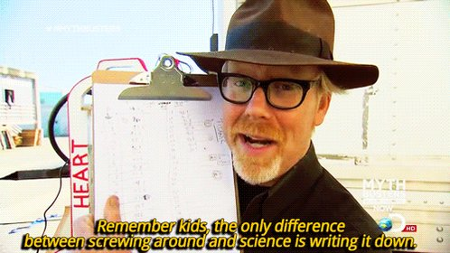
Presenting your science is a critical part of the science
Notes:
Presenting the science is so important! Why do you think presenting science is important?

Slide 10
Presenting Science: Venues
Providing updates on your work or presenting your conclusion at a research group meeting
Writing a paper in a journal
Smaller meetings for a sub-field (like the TESS Science Conference)
Large meetings for the entire field (like the American Astronomical Society meetings)
Keep an eye out for: The UW Undergrad Symposium
Notes:
Will need to explain what a group meeting is, talk about how many people at each meetings (could be 3000 for the american astronomical society, some have 1000 like the AAS division of planetary science; others have between 50 for collaborations and 5-10 for a lab meeting)
Some of these are talks, some of these are posters
David: PreMAP talks? (or too soon haha?)

Slide 11
Presenting Science: Informal Conversations
Even just talking with people about what you do in the hallway is presenting your science

Slide 12
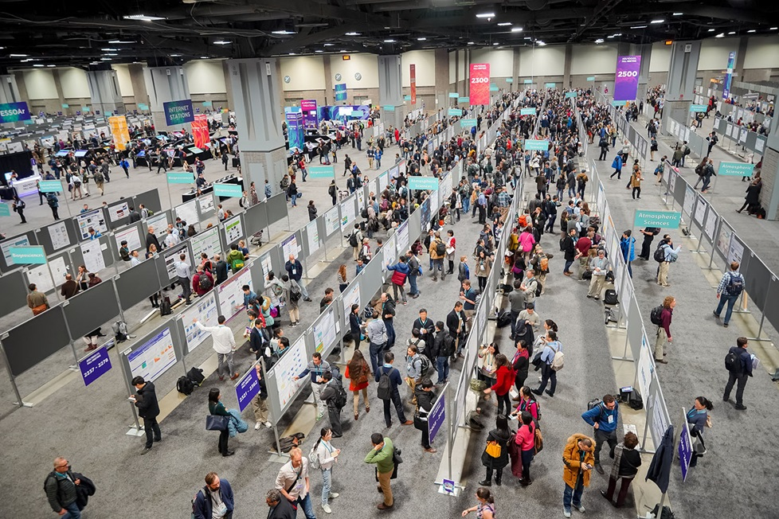
Presenting Science: Formal Presentations
Public talks
Poster presentations
The poster hall at the American Geophysical Union meeting

Slide 13
Presenting Science: Writings
Science is communicated to the public through newspapers, while science is communicated to other scientists via scientific journals. These can range from broad to niche
  E.g., Nature, Science, The Astrophysical Journal, Astrobiology, Astronomy and Astrophysics, Monthly Notices of the Royal Astronomical Society
  Note: The arxiv is a website where “pre-prints” are published, which are scientific papers that are going to be published but haven’t yet been
Part of this class’ goal is to help you be comfortable looking at scientific papers
Scientists often don’t read a whole paper
Notes:
David: Usually I look at the pictures first (figures)
Also starting in 2019, the abstracts of the annual reviews of astronomy all summarize the key information about the field in a few bullet points: https://www.annualreviews.org/toc/astro/60/1

Slide 14
Doing Science: The Flow
Do what you need to do to collect data for your idea (this is often called a methodology)
Turn that data into a conclusion (this is called analysis)
Look at context, are there gaps? Can you fill them?
Present that conclusion
Look at context, are there gaps? Can you fill them?
How is this process going? Have you dotted the i’s and crossed the t’s?
Notes:
When you present that conclusion (either orally or in writing) you want to present everything, from the context to the data collected, the methods and your results. And when you present you will see that other scientists that are interested in your work, they will have questions about it and that will bring you back to that first step: are there any gaps? If so, science will keep up happening!

Slide 15
How did what we see as the important aspects of research overlap with what you thought of as the important aspects of research?

Slide 16
How did what we see as the important aspects of research overlap with what y’all thought of as the important aspects of research? What are some similarities and differences? Are there parts of research that you do or don’t look forward to?

